Slide 2
STATISTICS
Statistics is a form of mathematical analysis that uses quantified models, representations and synopses for a given set of experimental data or real-life studies. Statistics studies methodologies to gather, review, analyze and draw conclusions from data.

Slide 3
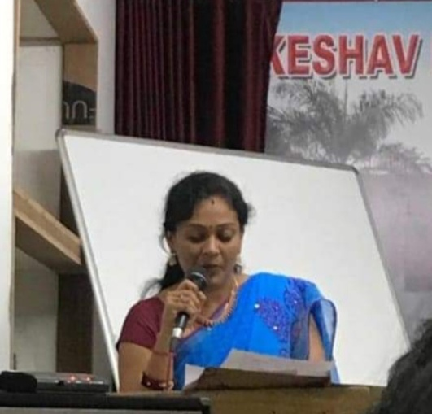
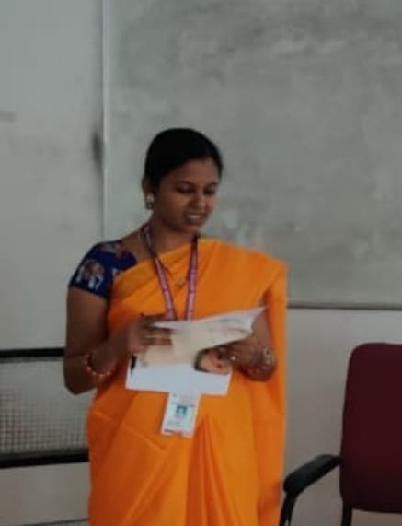
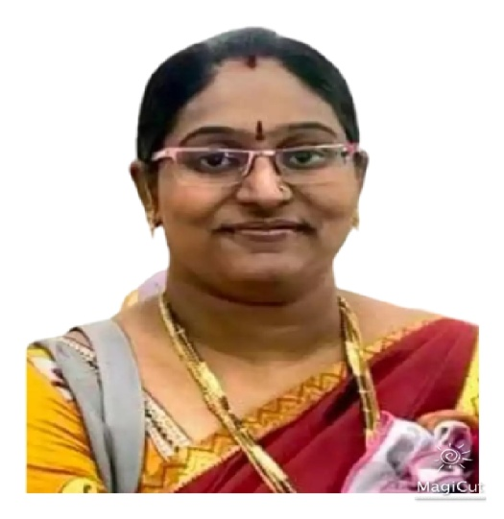
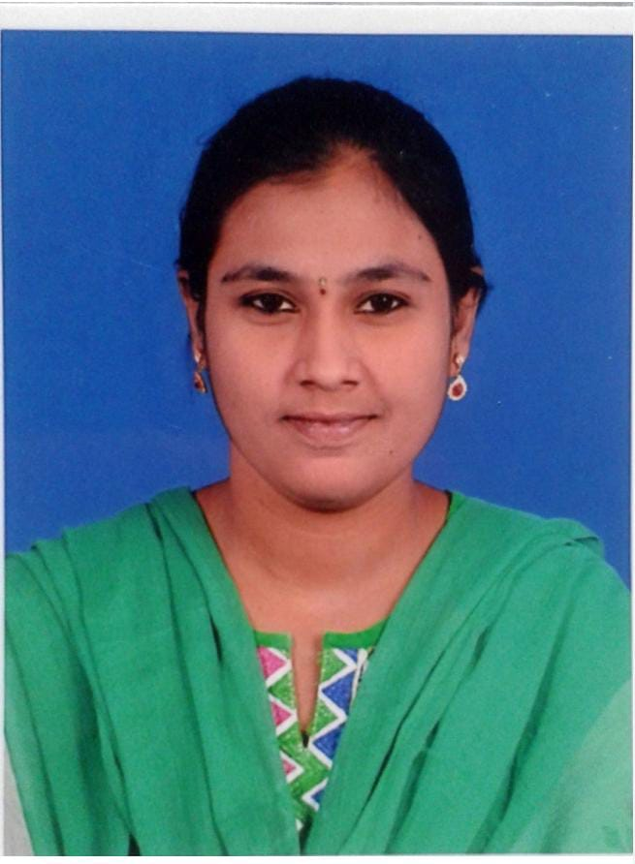
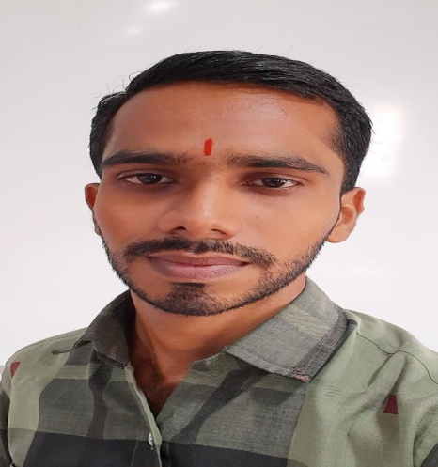
Department of Statistics
Mrs. V. Sumalatha
HOD (PG)
Mr. M. Kanaka Reddy
Faculty of PG
Mrs. A . Lavanya
Faculty of PG
Mr. Sripadh Deshpande
HOD(UG)
Mrs. Y. Sri Nirupama
Faculty of UG
Miss. T. Pavani Durga
Faculty of PG

Slide 4
NATIONAL STATISTICS DAY CELEBRATIONS

Slide 6
National Statistics day celebrations on 29th June 2017 to mark the birth anniversary of India’s eminent statisticians late professor Prasanta Chandra Mahalanobis. It was organized by department of Statistics.
Chief guest Dr. M.Jaganmohan Rao, Principal of Jagruthi Degree & PG college and the author of many books on Statistics for under graduate level

Slide 7
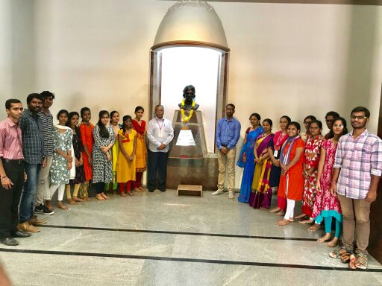
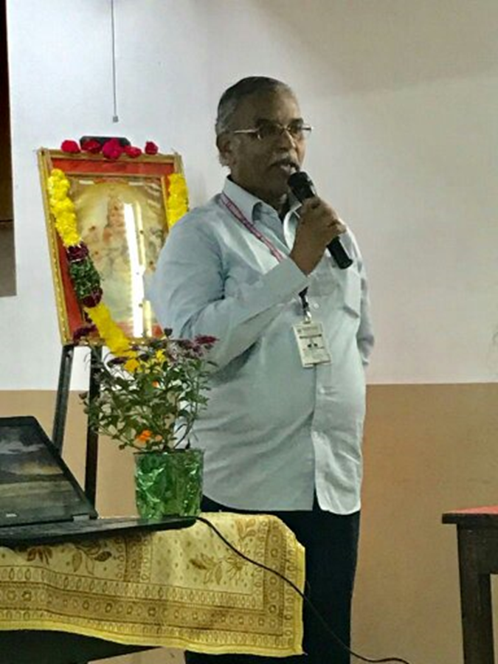
GUEST LECTURE ON APPLICATIONS OF STATISTICS AND CAREER GUIDENCE

Slide 8
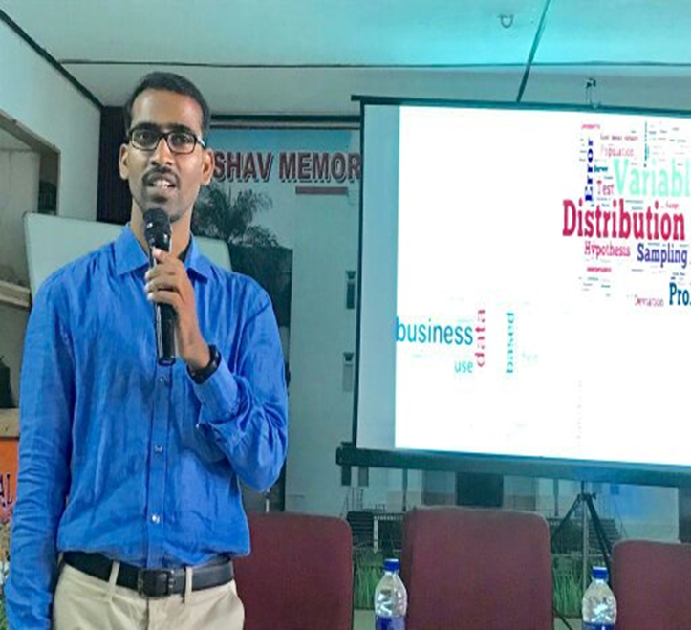
Department of statistics conducted guest lecture on 9/11/2019 on “Statistics in Various fields & Career Guidance” by Mr. Anil Kumar Thota , Deputy General Manager, cognizant.
Mr. Anil Kumar discussed about statistics with real life examples he also introduce the participants in many exclusive examples and case studies in Business, Economics, Bio-Statistics & Data Modeling’s. He also shared his personal experiences about his career. The students were able to know about the various skills like R, Python, SAS, SPSS & Advanced Excel, that are required being an informative speaker then he shared the skills required for a leads to excel in the job.

Slide 9
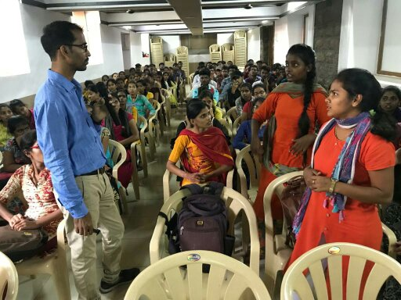
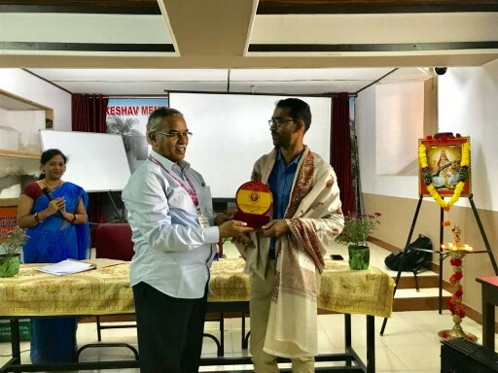

Slide 10
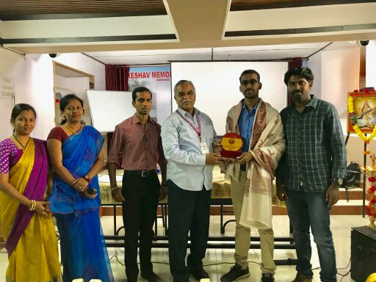

Slide 11
GUEST LECTURE ON ROLE OF STATISTICS TOWARDS DECISION MAKING
Department has conducted Lecture on 14-03-2020 on “Role of statistics towards decision making” by Mr. M. Kanaka Reddy, Research scholar, Osmania university.

Slide 12
He explained the importance of statistics in taking decision at various fields. He also informed that the statistics subject is very important to get into various competitive examinations to be organized by the Government Departments.
He also explained about Statistics is an indispensable tool for National development, growth and planning and a government without viable infrastructure for information generation, dissemination and usage is severely handicapped in doing proper planning, monitoring and evaluation of development programmes and projects and also in arriving at good decision with respect to their government policy formation.
He also explained the role of statistics in IS/IT (information systems and information technology) in general can be substantial, yielding more nearly optimal performance of problems at the emerging frontiers in all their aspects.

Slide 13
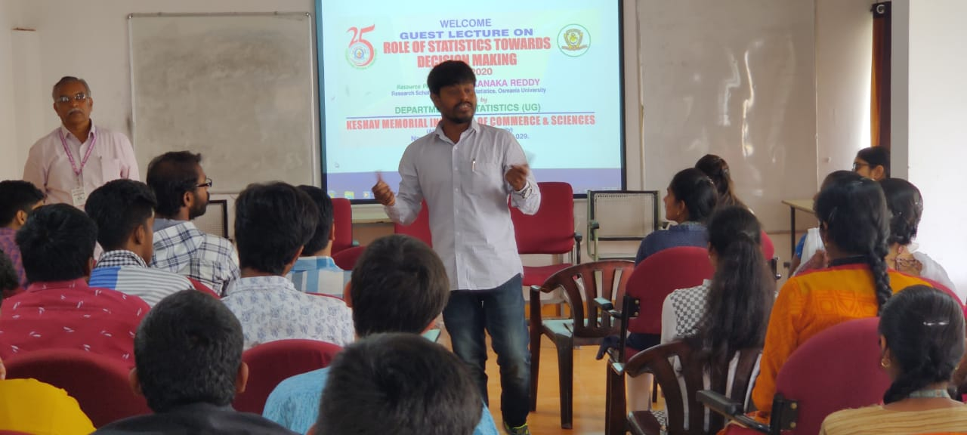

Slide 14
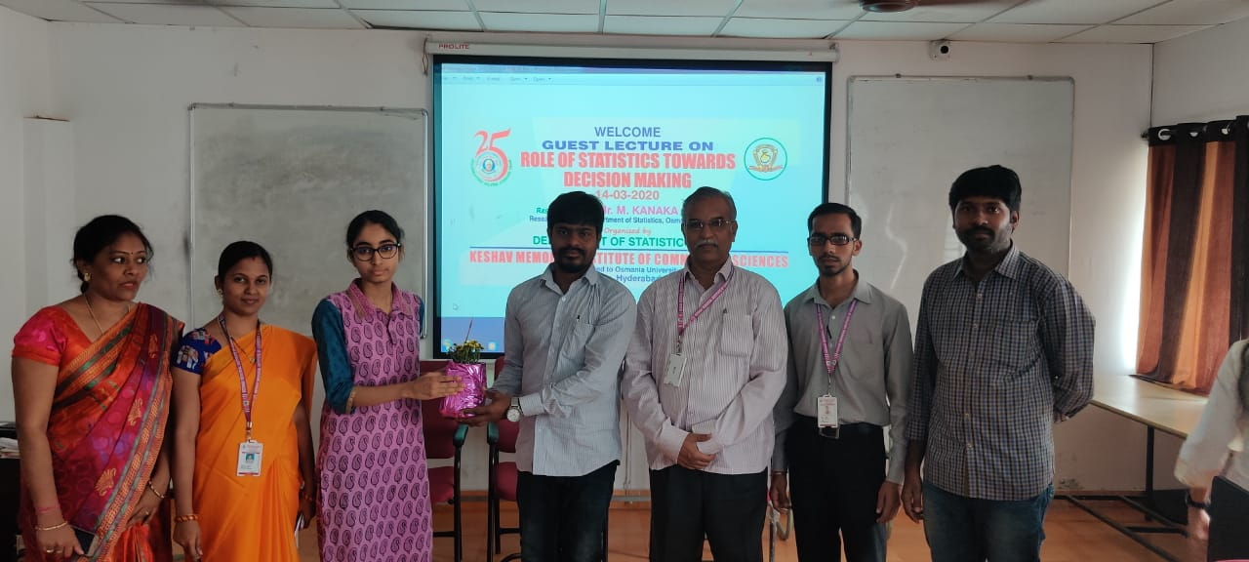

Slide 15
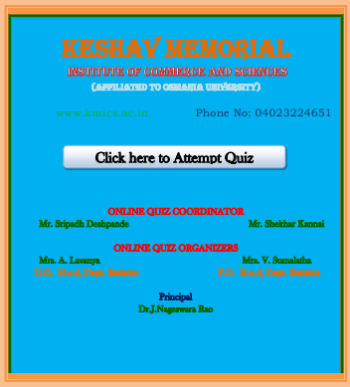
QUIZ ON BASIC STATISTICS
Department has conducted ONLINE QUIZ during lockdown on BASIC STATISTICS.
More than 500 students has participated from different colleges.

Slide 16
A Virtual program “SKILL HUNT” was conducted by the Department of Statistics during the lockdown in the month of August. The agenda of the program is to provide
“A Virtual platform to prove their talents”
In the competition the students were asked to send their skills like Singing, Dancing, Painting, Cooking, and many more in the form of photos and short videos by 30th July 2020 and the prizes were distributed on 2nd August 2020.

Slide 17
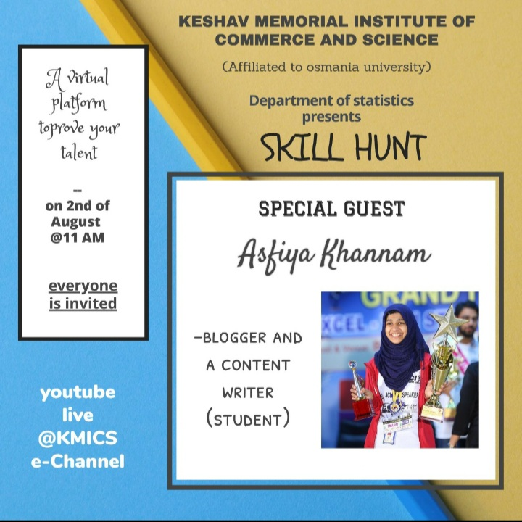

Slide 18
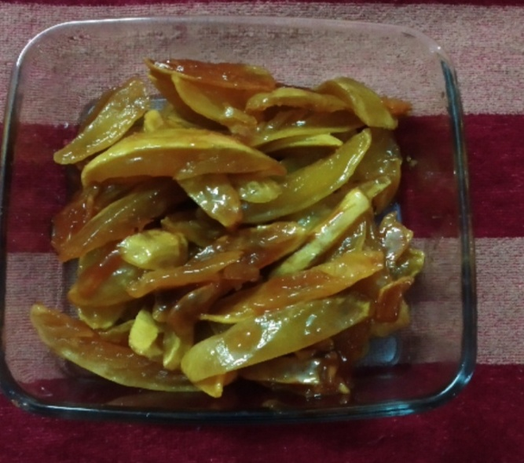
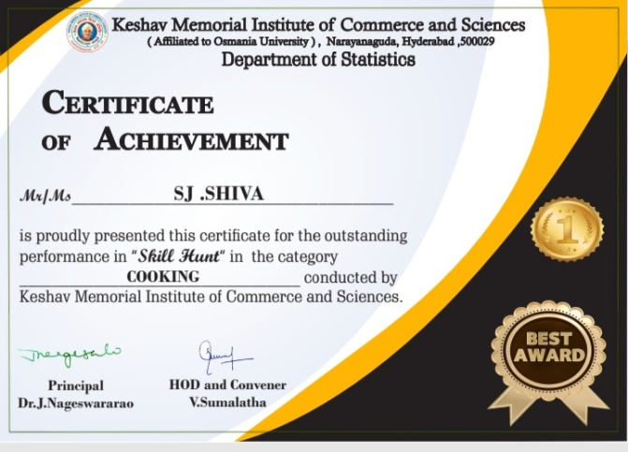
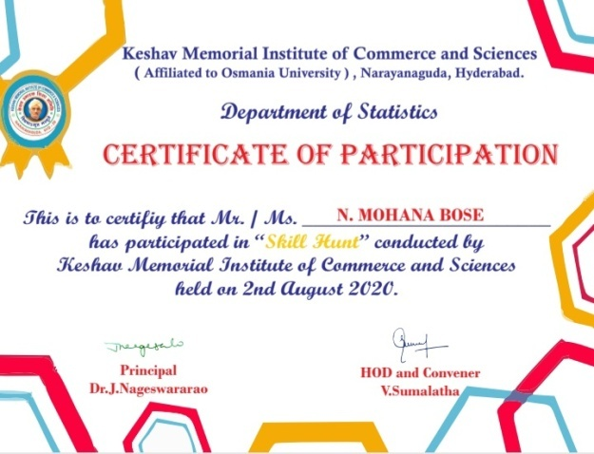

Slide 19
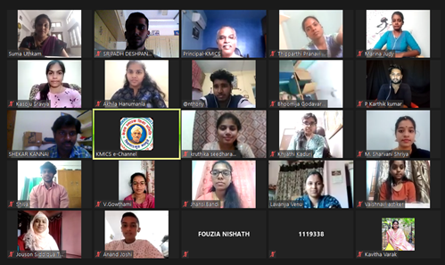
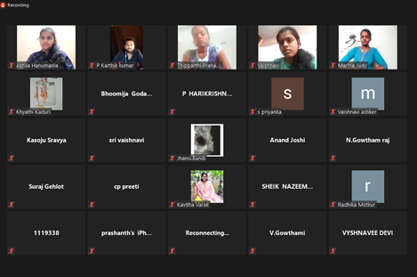

Slide 20
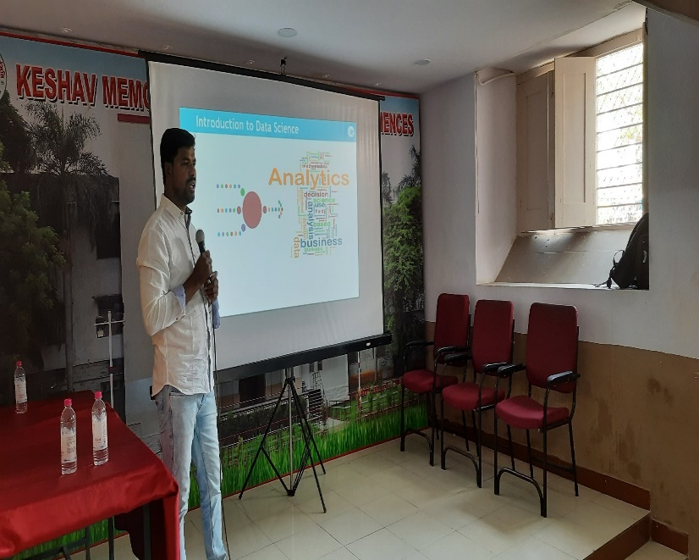
Guest Lecture about Career Guidance
A guest lecture was conducted on “EMERING ROLES AND CAREER GROWTH IN THE CURRENT INDUSTRY” on 26th February 2021 by K.Raju –Manager, Data science IBM. The program was started by the introduction of the guest by Mrs. A.Lavanya Lecturer in Statistics, followed by addressing the students by our Principal.
The guest spoke about the career growth in the current industry and explained the role of statistics with live examples. He also discussed Data Analytics in the field of banking sector.
The program ended with the vote of thanks by Marina Judy student of MSc. Statistics.

Slide 21
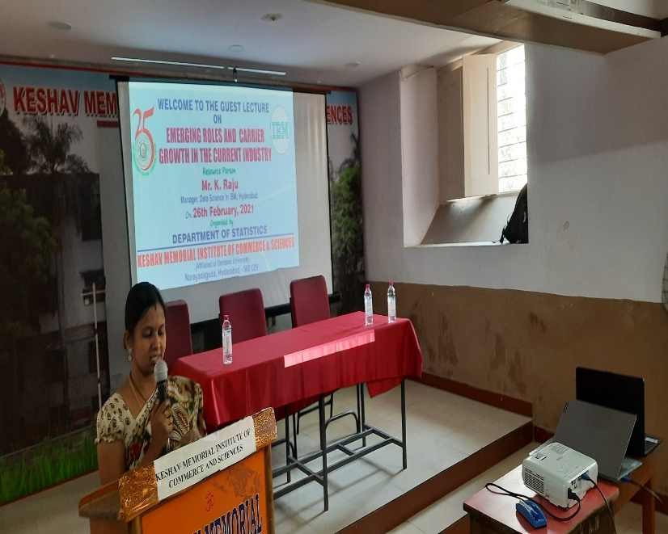
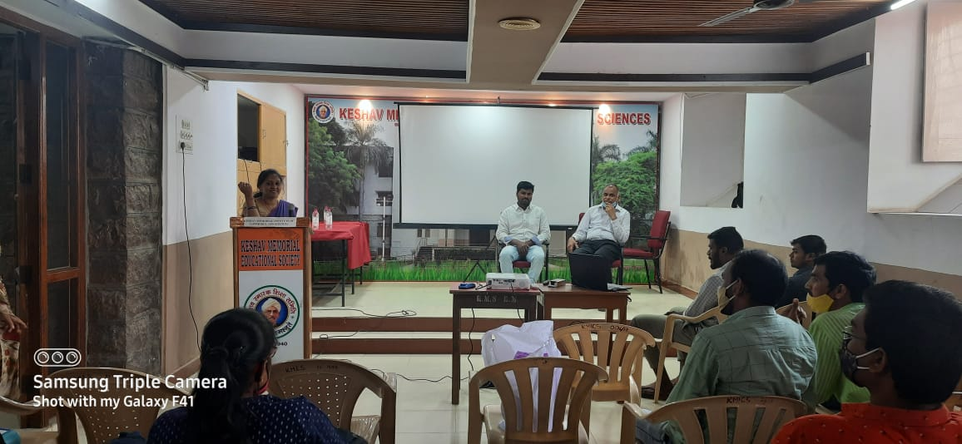
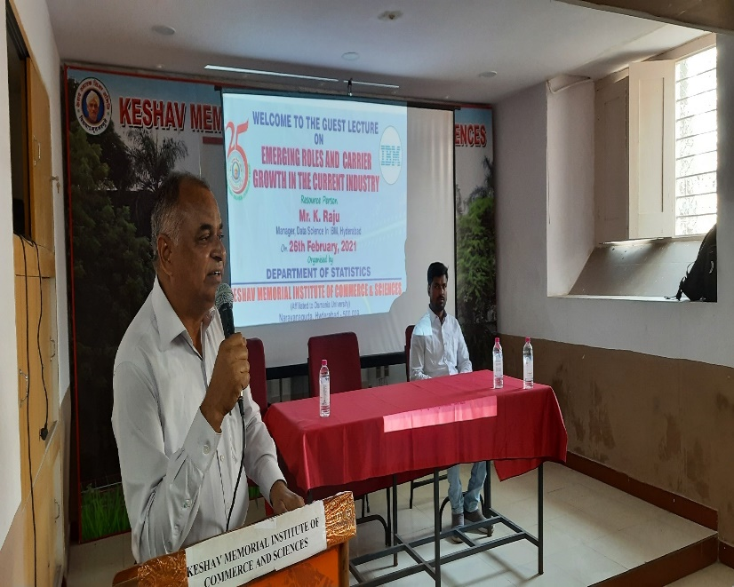
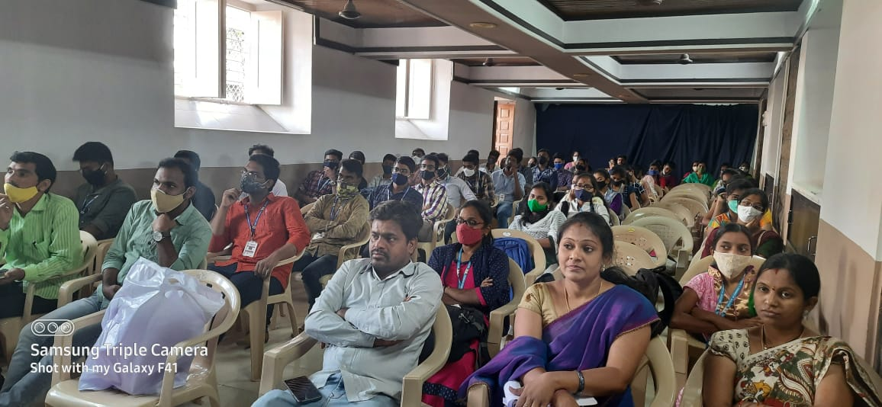
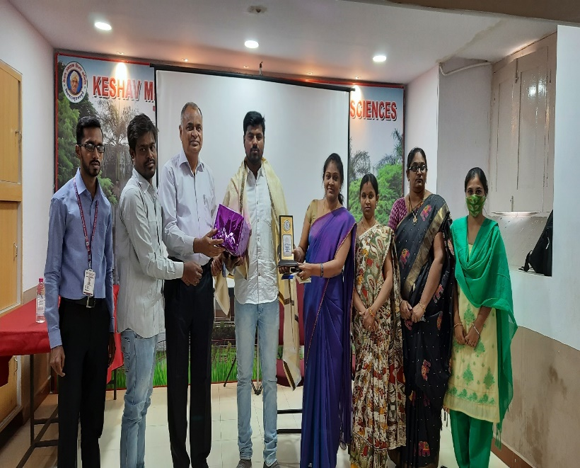

Slide 23
National Webinar On Role of Statistics in Scientific Research
On the occasion of 15th National Statistics Day Department of Statistics, KMICS organized a National Webinar on “Role of Statistics in Scientific Research” by Dr. M. Raghavender Sharma, Asst. Prof. UCS, OU, Hyderabad.
The Speaker discussed introduction to the Statistics and process of data collection, how statistics is used in daily life and research oriented topics related to the field of statistics. The speaker interacted with the students and guided them to grab the opportunity in research field.

Slide 24
National Webinar on Statistical Data Analysis using SPSS
In the session II, a webinar on “Statistical Data Analysis using SPSS” by Dr. G. Sirisha Asst. Prof. UCS, OU, Hyderabad.
Madam gave a detailed Lecture on SPSS, how to use Descriptive Statistics, Design of Experiments and Factorial designs using SPSS software. She explained many statistical topics by presenting different Slides with the help of examples. Many of the students clarified their doubts in using the SPSS Software.
We got 300 responses regarding our National Webinar.

Slide 25
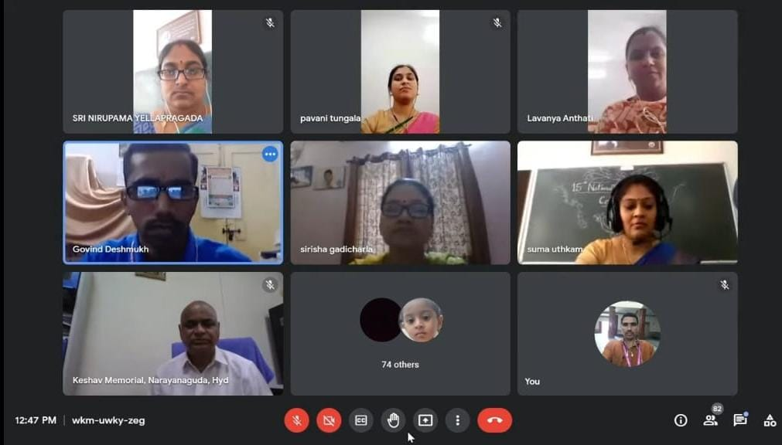

Slide 26
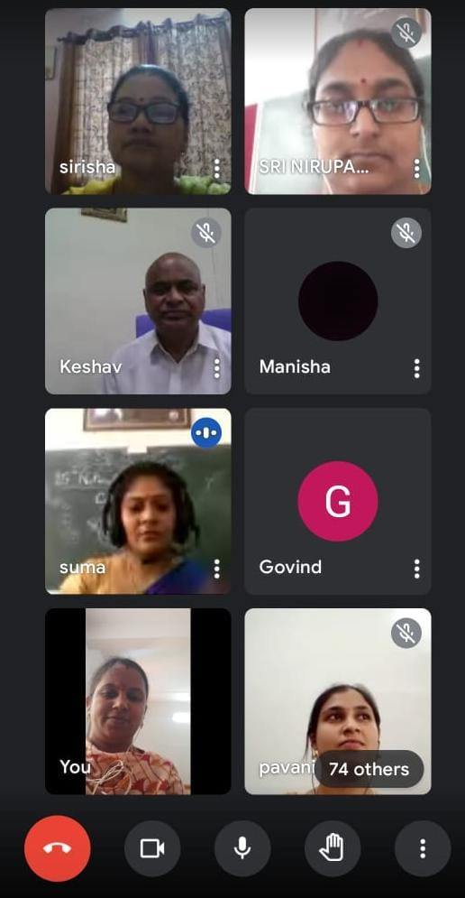
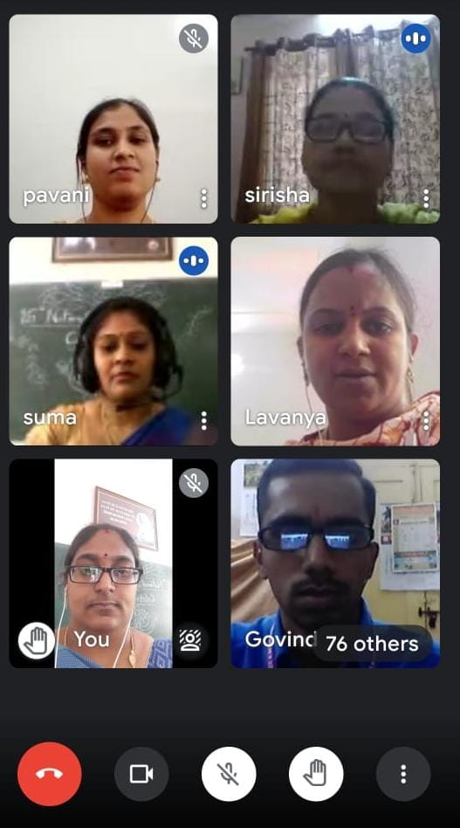
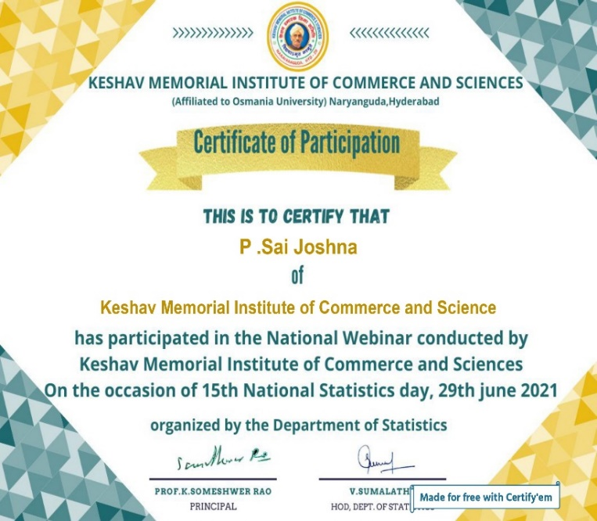
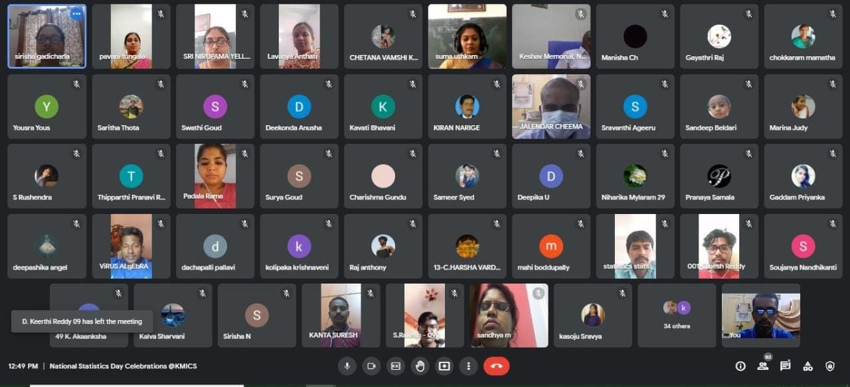

Slide 27
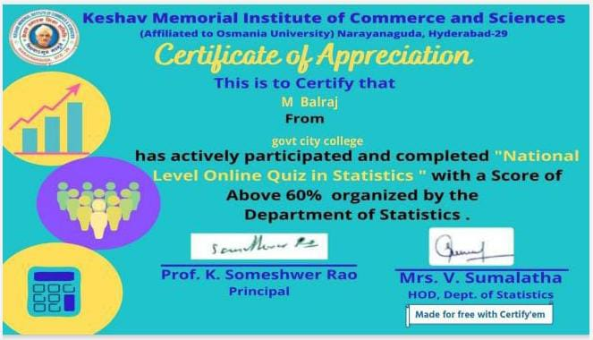
National Level Online Quiz in Statistics
Department has conducted ONLINE QUIZ on occasion of 81st Foundation Day of Keshav Memorial Education Society on 17th July 2021 , Quiz form enable from 9:00 am – 9:00 pm.
More than 500 students has participated from different colleges.
We provide First and Second Prizes.

Slide 28
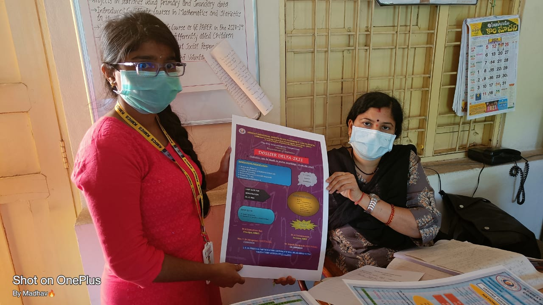

Slide 29
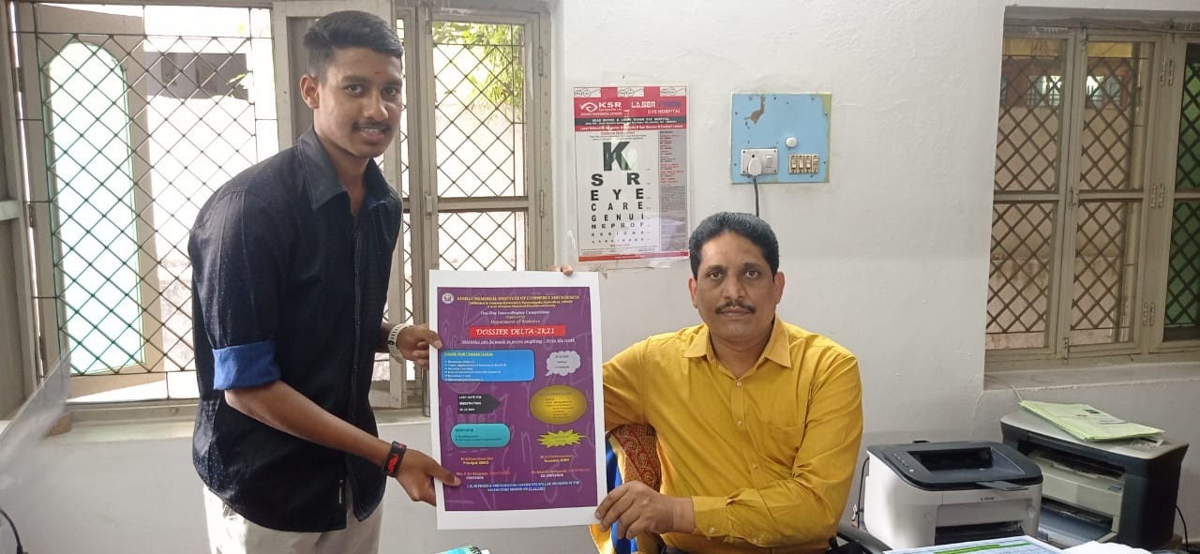
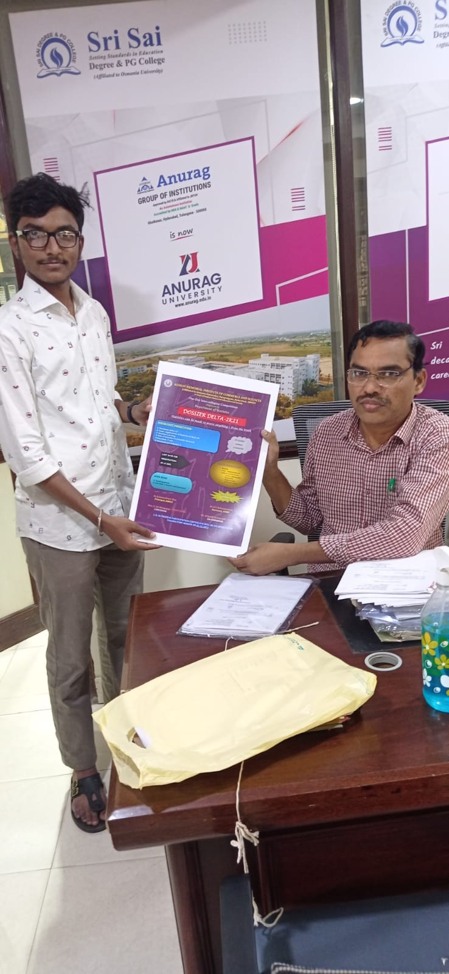

Slide 30
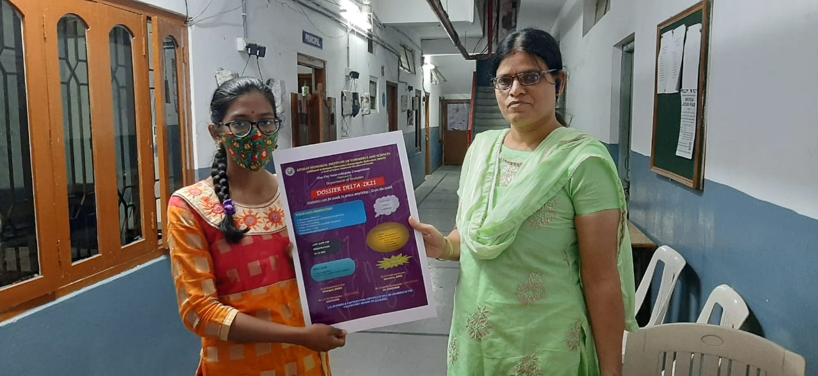

Slide 31
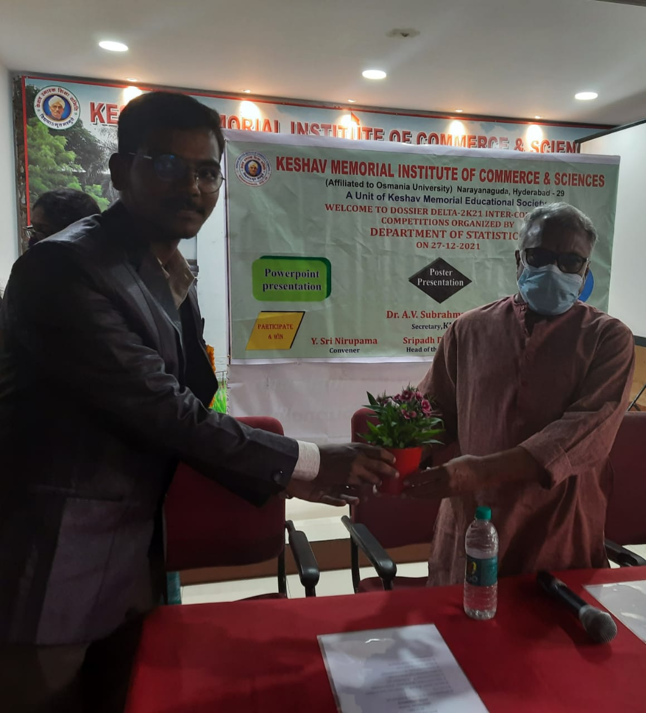

Slide 32
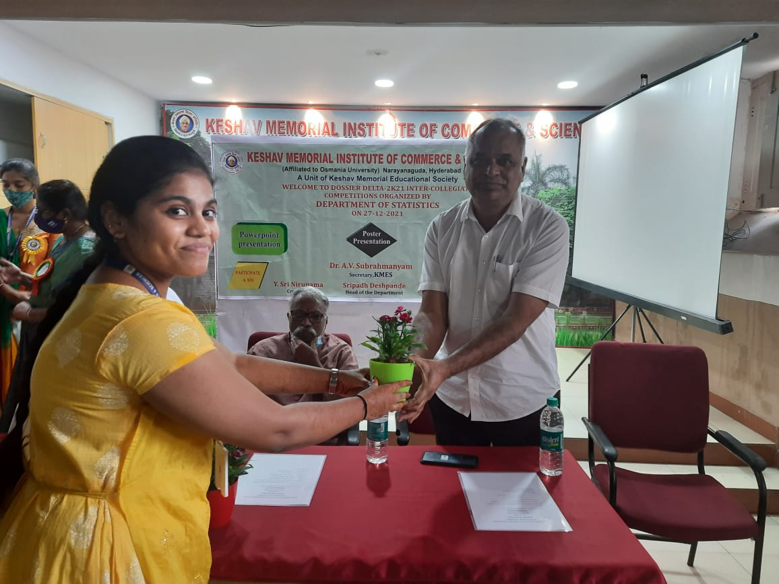

Slide 33
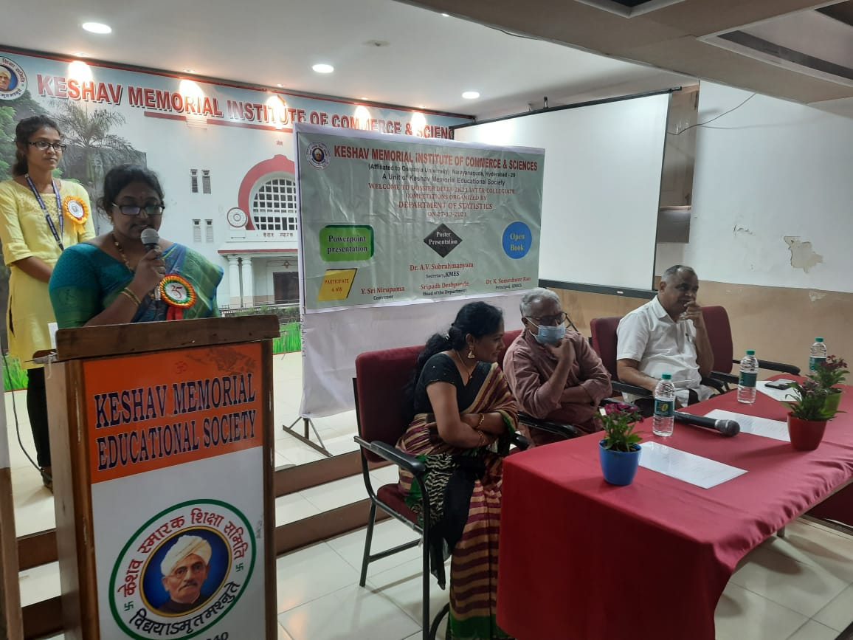

Slide 34
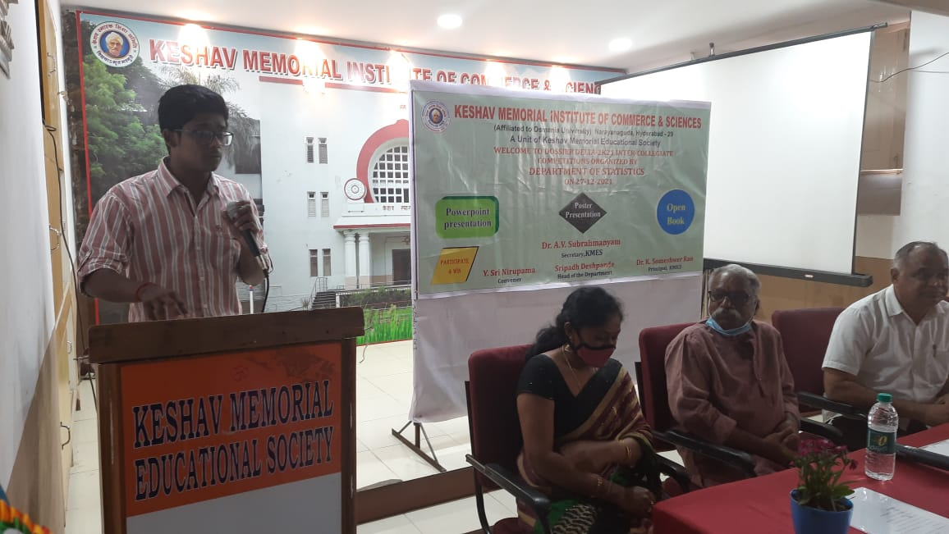

Slide 35
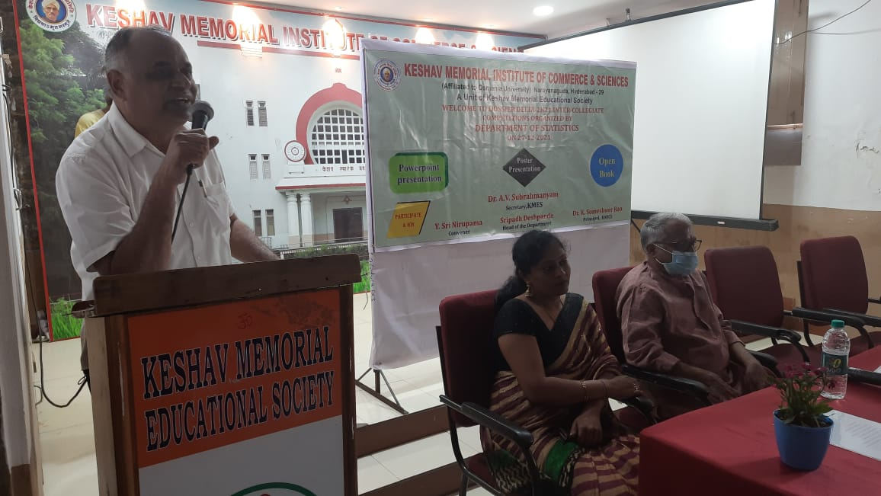

Slide 36
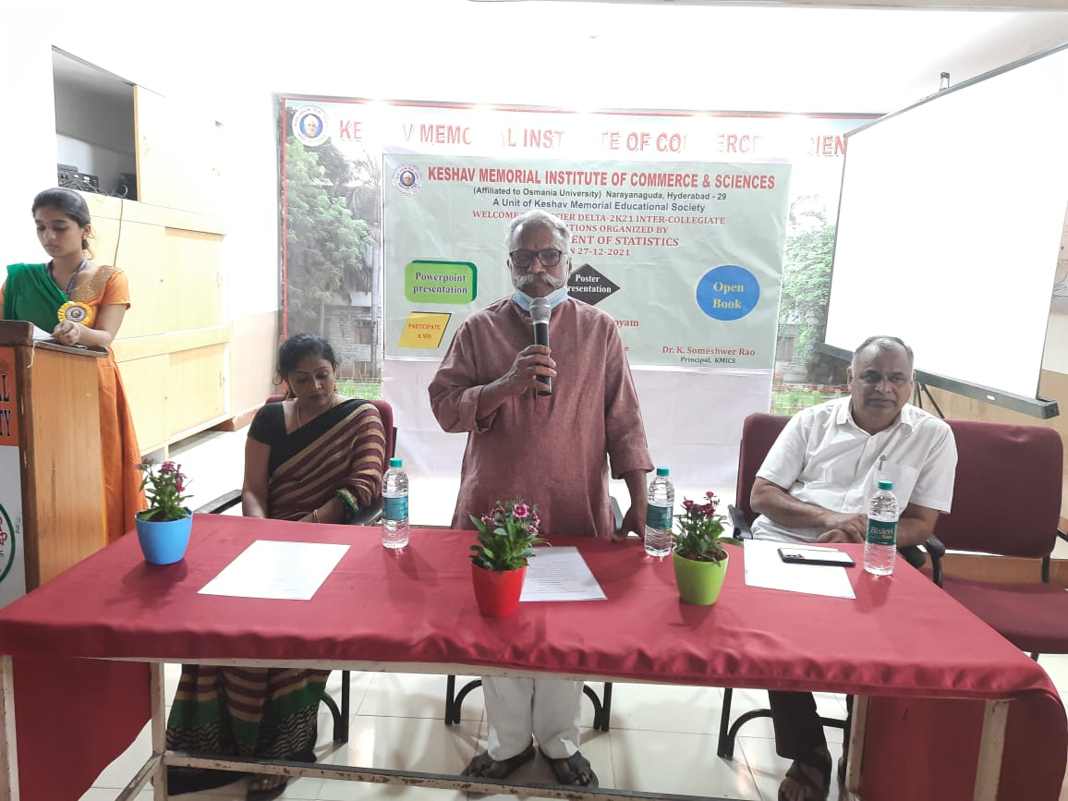

Slide 37
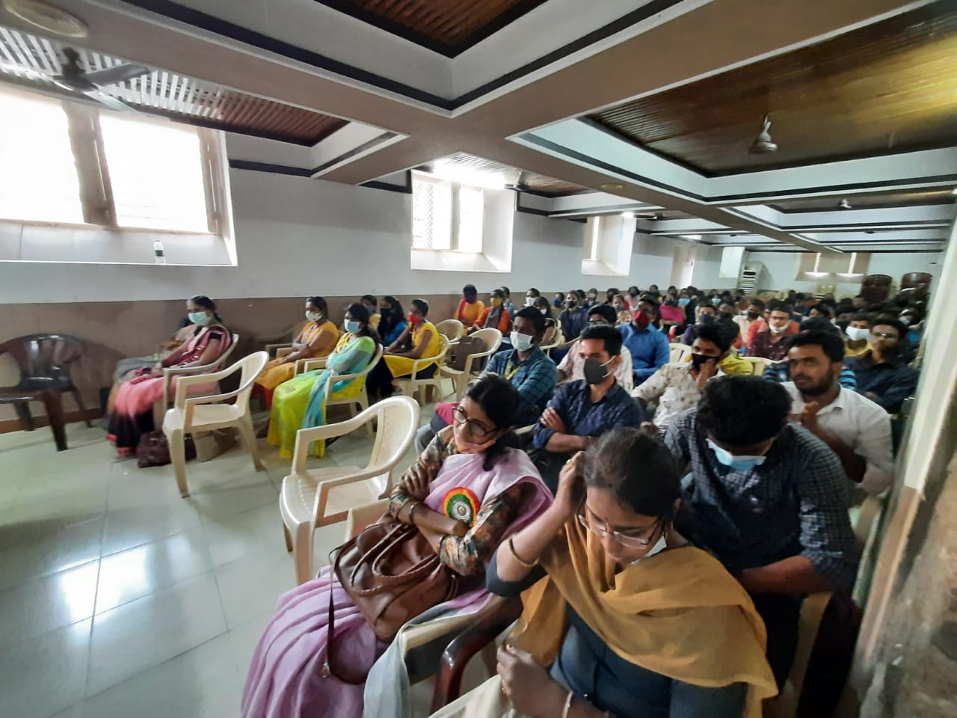

Slide 38
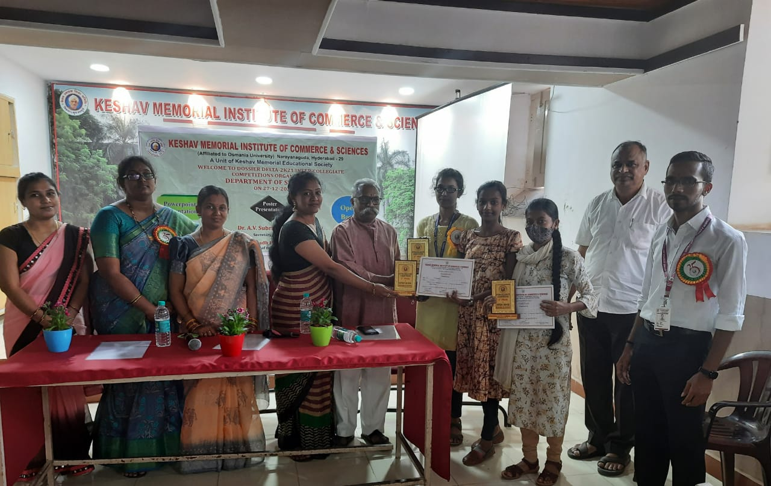

Slide 39
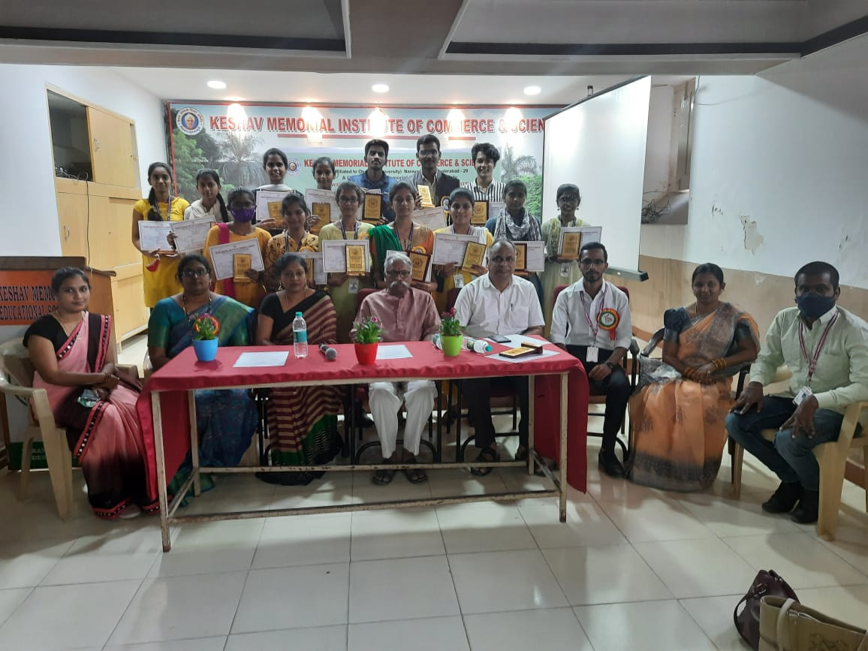

Slide 40
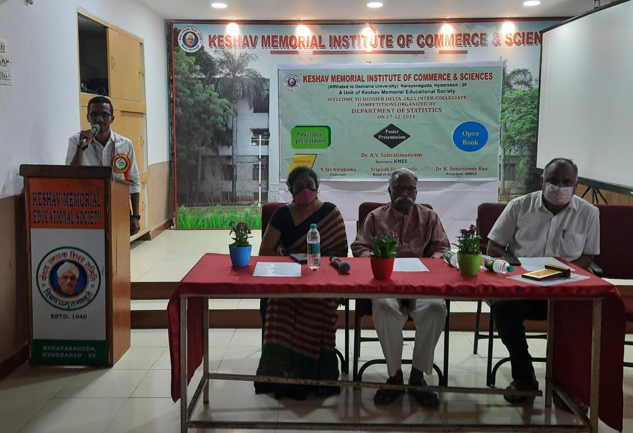

Slide 63
THANK YOU

